Slide 1

Final Project
DETECTING DISASTERS FROM TWITTER DATA

Slide 2
Summary of Presentation
Project Topic
Data Analysis
Model Training
Results

Slide 3
Project Explanation
Use NLP to analyze twitter data and
classify text
Popular beginner’s Kaggle challenge
Over 1,000 people have attempted the challenge
Tweet about a real disaster or not?
~ 7,600 Tweets
7 different Models

Slide 4
Data Analysis
ID - Discarded
Keyword
Text
Assigned by data labelers
Location
Text…sometimes
Optional, user entered
Text
Text…sorta
The body of the tweet
Target
Binary, real disaster or not
Keyword | Location | Text | Target
ablaze | Reading a book | Man, this book is fire… | 0
crash | AFRICA | TRUCK ABALZE… | 1
car%20crash | milky way!! | ##??http:blah… | 0

Slide 5
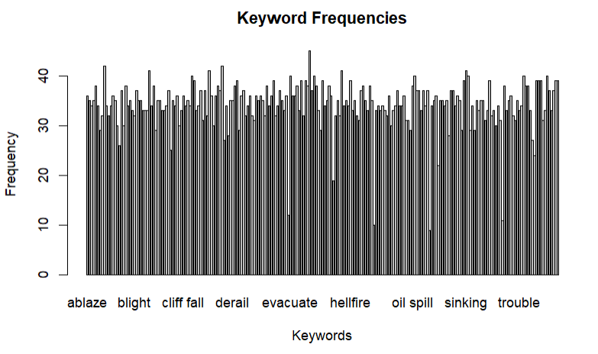
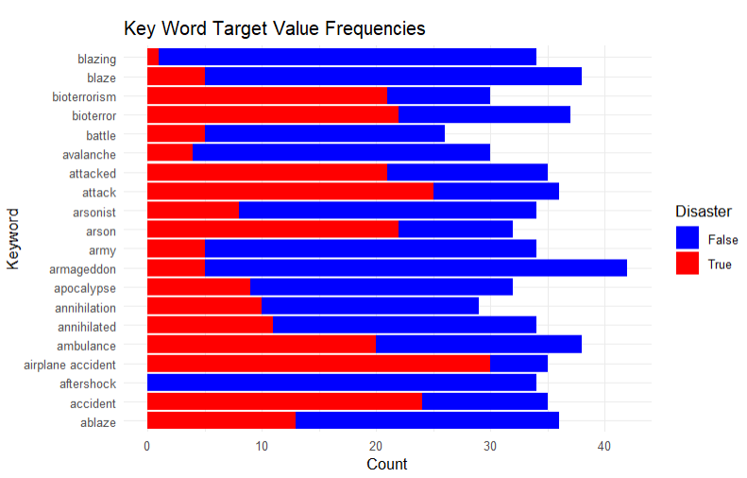
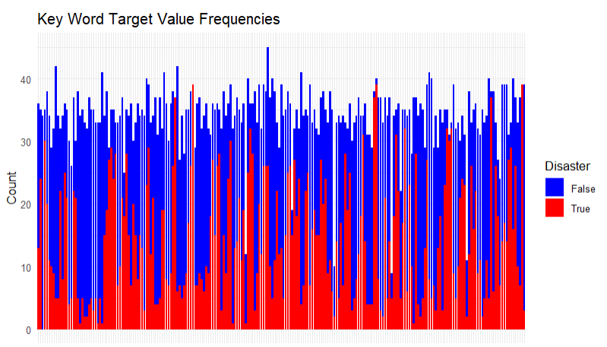
Keyword Variable
Fairly Clean
Few Missing
Hard to Impute
Hash Encoded

Slide 6
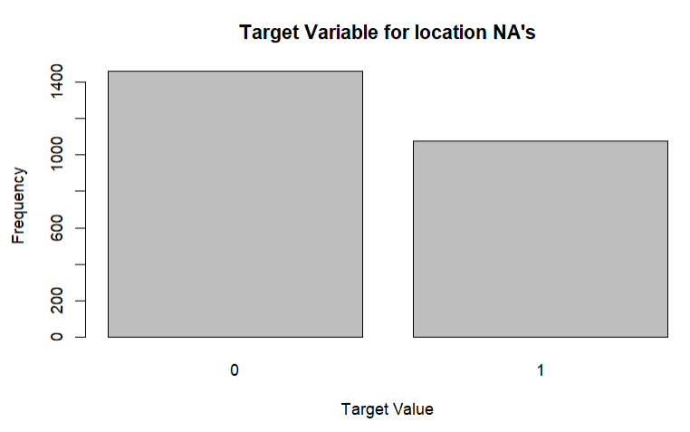
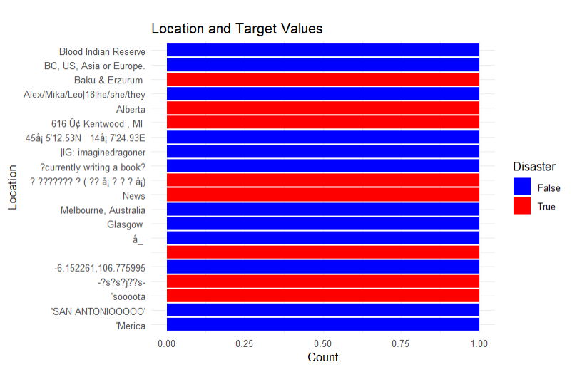
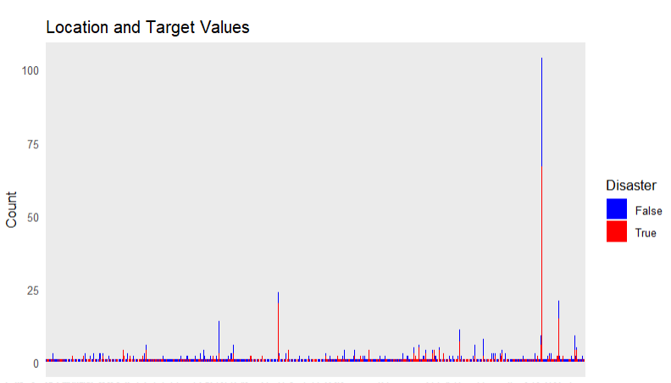
Location Variable
A Mess
Mostly Unique
Hard to Impute
Hash Encoded

Slide 7
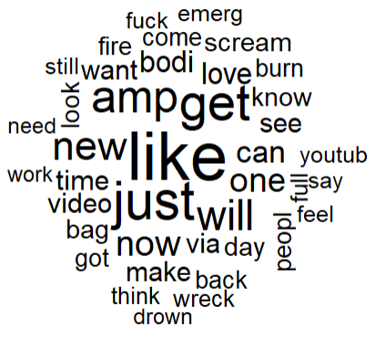
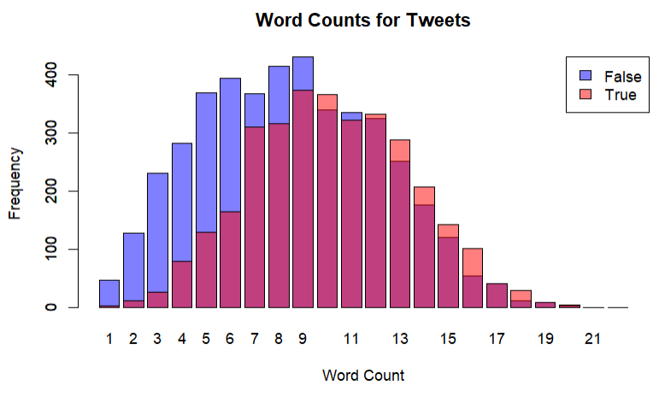

Text Variable
Needs Cleaned
Over 6000 unique words
None missing
TF-IDF Encoding

Slide 8
KNN Classifier
Naïve Bayes
Elastic Net Regression
Random Forest
Gradient Boosted Machine
Support Vector Machine
Neural Network
Majority Vote Ensemble
Machine learning models

Slide 9
Training and Evaluation
~ 6,900 Rows of Training Data
90/10 Split for Train/Test Sets
~ 530 Columns/Variables
TF-IDF is Z Normalized for all models
Caret Auto Tuning and FRUNS/FLAGS
10 – Fold Cross Validation
F1, Accuracy, AUC, Precision, Recall
Majority Class Heuristic

Slide 10
Results
MODEL | ACCURACY | AUC
Random Forest | 81.1 % | 0.8031
Majority Vote | 79.9 % | 0.7816
SVM | 78.7 % | 0.7729
Elastic Net | 78.4 % | 0.7689
GBM | 77.3 % | 0.7458
KNN | 74.5 % | 0.7182
Neural Network | 74.1 % | 0.7375
Naïve Bayes | 71.8 % | 0.6882
Majority Classifier | 57.6 % | -

Slide 11
THE END
DETECTING DISASTERS FROM TWITTER DATA

